Slide 1
AI in Gaming
Explained for beginners
Introduction
History Of AI in Gaming
Evolution Of AI in Gaming
Popular AI Based Games
Rida Tariq

Slide 2
Introduction
Purpose of AI in gaming
Game categories targeted by AI
AI Agent

Slide 3
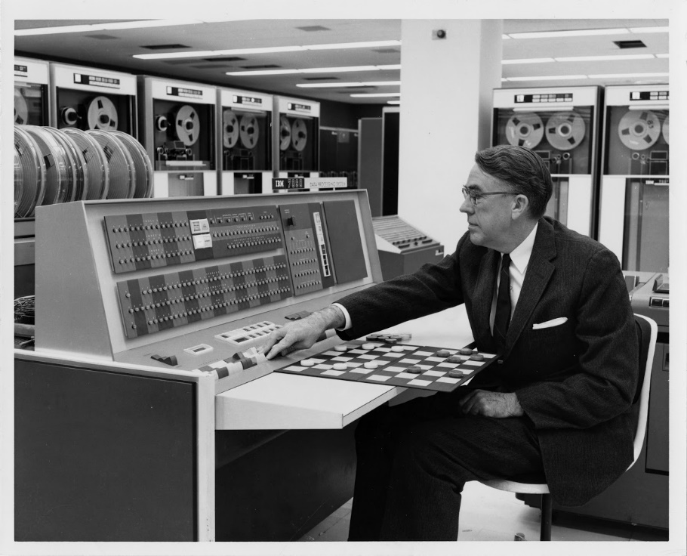
History Of AI in Gaming
Computer checkers (1952)
Arthur Lee Samuel

Slide 4
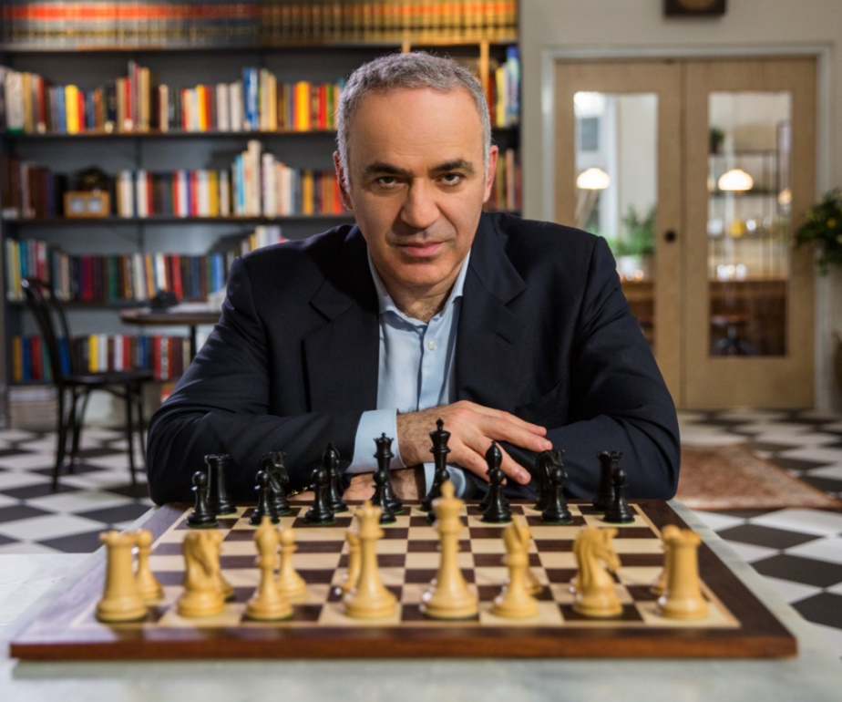
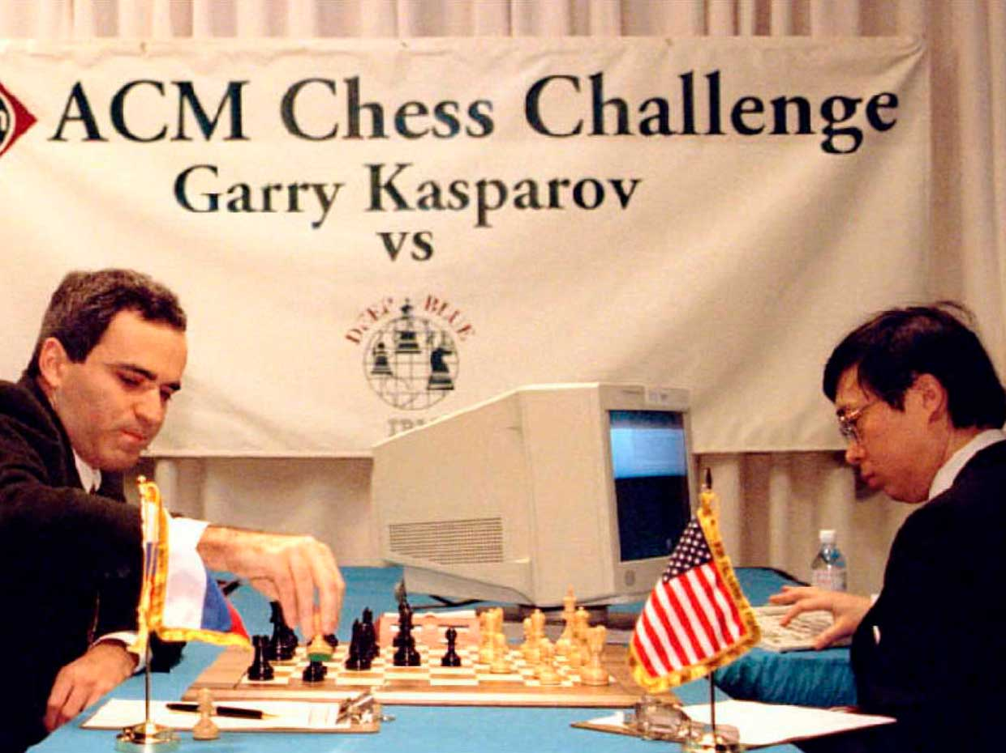
History Of AI in Gaming
IBM’s Super Computer Deep Blue (1997)
Garry Kasparov

Slide 5
Evolution of AI in Gaming
Pong (1972)
Pac-Man (1980s)

Slide 6
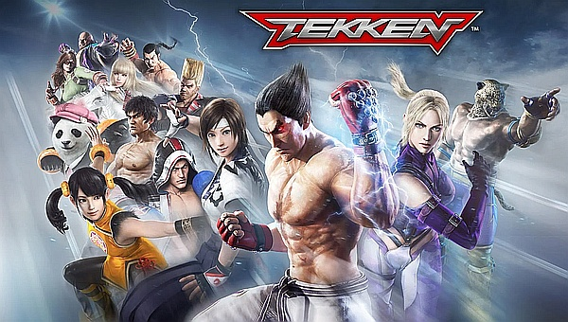
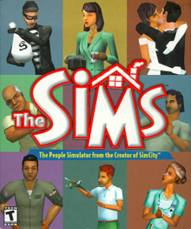
Evolution of AI in Gaming
Tekken (1994)
The Sims (2000)

Slide 7
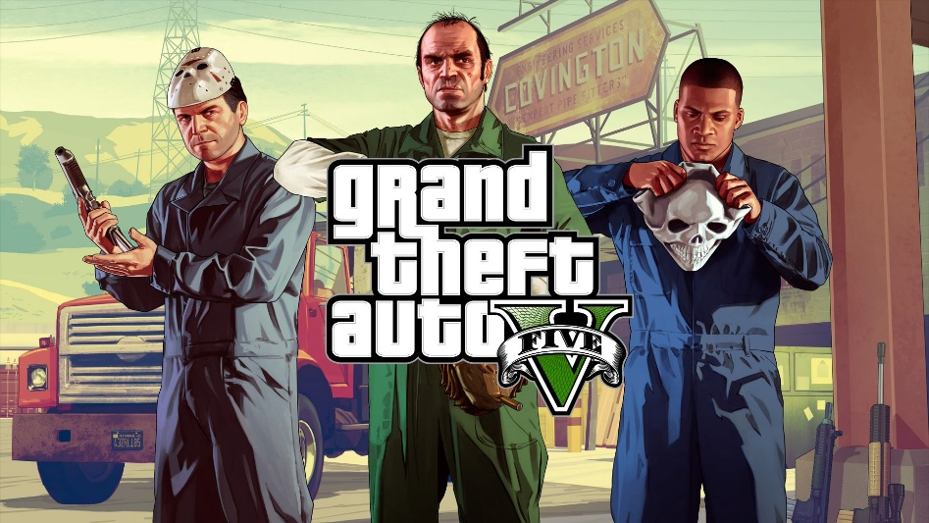
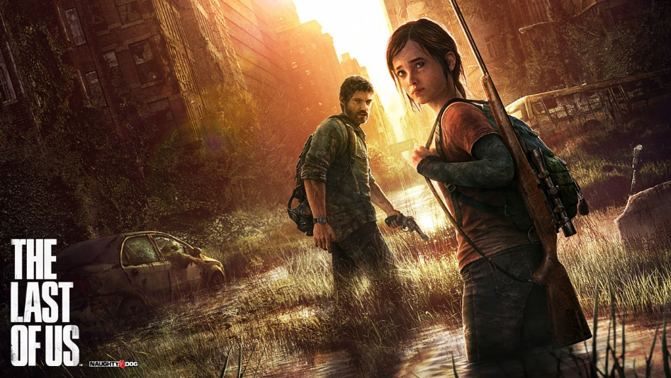
Popular Ai based Games
Grand Theft Auto
The Last Of Us

Slide 8
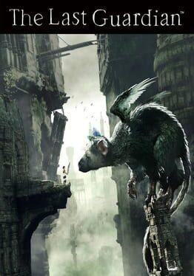
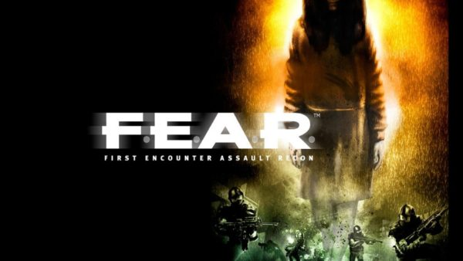
Popular Ai based Games
The Last Guardian
Fear

Slide 9
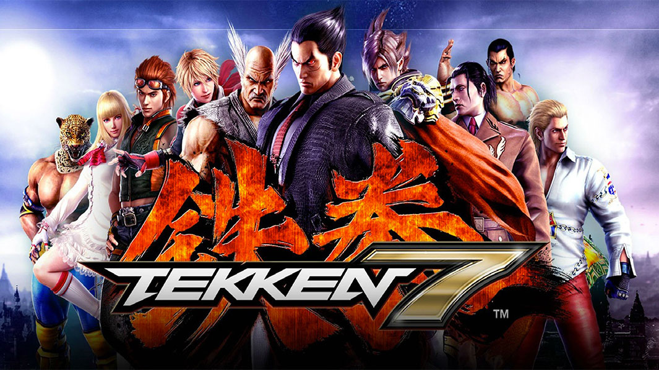
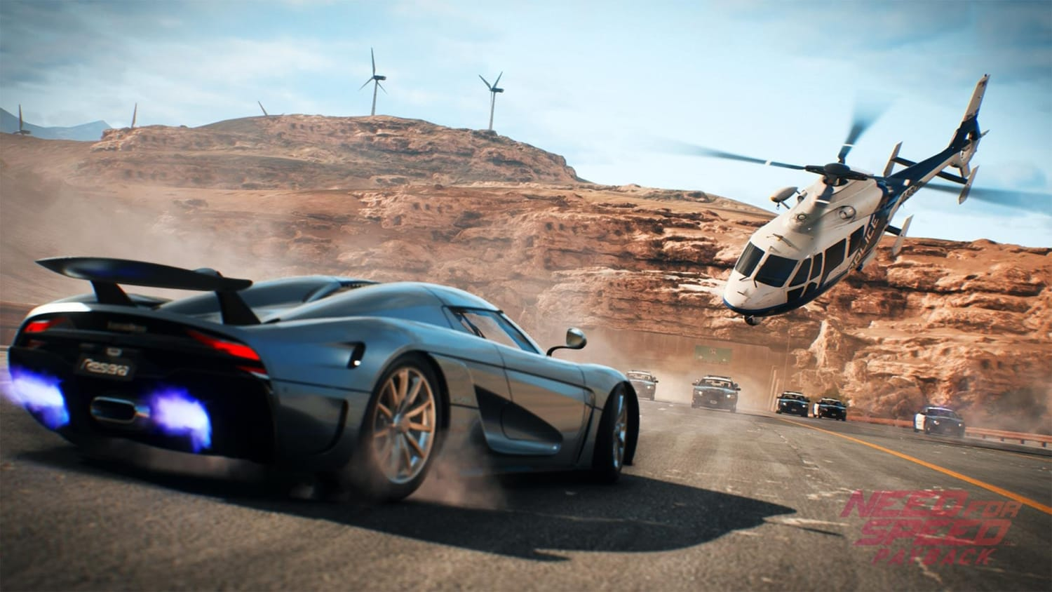
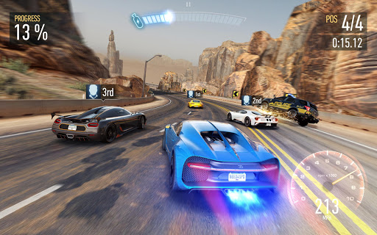
Popular Ai based Games
Tekken
Need for speed

Slide 10
Website : www.aisciences.io

